Slide 1
CT-581
Statistics & Probability for Data Science

Slide 2
Recommended Books:
The Elements of Statistical Learning: Data Mining, Inference, and Prediction, Trevor Hastie,‎ Robert Tibshirani,‎ Jerome Friedman.
All of Statistics: A Concise Course in Statistical Inference, Larry Wasserman.
Probability & Statistics for Computer Scientists, Michael Baron
Probability and Statistics for Engineer and Scientist Ronald E. Walpole, Raymond h. Myers, Sharon L. Myers, Keying E. Ye.
A selection of conference and journal papers as appropriate.

Slide 3
Lecture 1:
Introduction to Statistics

Slide 4

What Is Statistics?
Chapter 1
McGraw-Hill/Irwin
Copyright © 2011 by the McGraw-Hill Companies, Inc. All rights reserved.

Slide 5
LEARNING OBJECTIVES
LO1. Understand why we study statistics.
LO2. Explain what is meant by descriptive statistics and inferential statistics.
LO3. Distinguish between a qualitative variable and a quantitative variable.
LO4. Describe how a discrete variable is different from a continuous variable.

Slide 6

Why Study Statistics?
Learning Objective 1 Understand why we study statistics.
Numerical information is everywhere
Statistical techniques are used to make decisions that affect our daily lives
The knowledge of statistical methods will help you understand how decisions are made and give you a better understanding of how they affect you.
No matter what line of work you select, you will find yourself faced with decisions where an understanding of data analysis is helpful.

Slide 7

What is Meant by Statistics?
LO1
Statistics is the science of collecting, organizing, presenting, analyzing, and interpreting numerical data to assist in making more effective decisions.

Slide 8
What is Meant by Statistics?
LO1
In the more common usage, statistics refers
to numerical information
Examples: the average starting salary of college graduates, the number of deaths due to alcoholism last year, the change in the Dow Jones Industrial Average from yesterday to today, and the number of home runs hit by the Chicago Cubs during the 2007 season.
Often statistical information is presented in a graphical form for capturing reader attention and to portray a large amount of information.

Slide 9
Formal Definition of Statistics
LO1
STATISTICS The science of collecting, organizing, presenting, analyzing, and interpreting data to assist in making more effective decisions.
Some examples of the need for data collection.
Research analysts for Merrill Lynch evaluate many facets of a particular stock before making a “buy” or “sell” recommendation.
The marketing department at Colgate-Palmolive Co., a manufacturer of soap products, has the responsibility of making recommendations regarding the potential profitability of a newly developed group of face soaps having fruit smells.
The United States government is concerned with the present condition of our economy and with predicting future economic trends.
Managers must make decisions about the quality of their product or service.

Slide 10
Who Uses Statistics?
LO1
Statistical techniques are used extensively by marketing, accounting, quality control, consumers, professional sports people, hospital administrators, educators, politicians, physicians, etc...

Slide 11

Types of Statistics – Descriptive Statistics and Inferential Statistics
Learning Objective 2 Explain what is meant by descriptive statistics and inferential statistics.
Descriptive Statistics - methods of organizing, summarizing, and presenting data in an informative way.
EXAMPLE 1: The United States government reports the population of the United States was 179,323,000 in 1960; 203,302,000 in 1970; 226,542,000 in 1980; 248,709,000 in 1990, and 265,000,000 in 2000.
EXAMPLE 2: According to the Bureau of Labor Statistics, the average hourly earnings of production workers was $17.90 for April 2008.

Slide 12
Types of Statistics – Descriptive Statistics and Inferential Statistics
LO2
Inferential Statistics: A decision, estimate, prediction, or generalization about a population, based on a sample.
Note: In statistics the word population and sample have a broader meaning. A population or sample may consist of individuals or objects

Slide 13
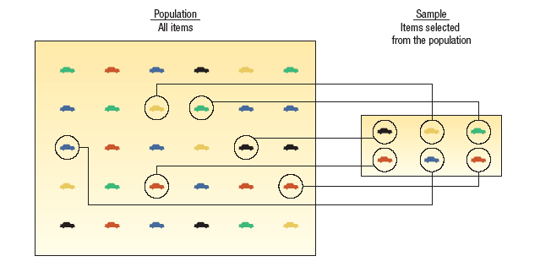
Population versus Sample
LO2
A population is a collection of all possible individuals, objects, or measurements of interest.
A sample is a portion, or part, of the population of interest

Slide 14
Why take a sample instead of studying every member of the population?
LO2
Prohibitive cost of census
Time
Destruction of item being studied may be required
Not possible to test or inspect all members of a population being studied

Slide 15
Usefulness of a Sample in Learning about a Population
LO2
Using a sample to learn something about a population is done extensively in business, agriculture, politics, and government.
EXAMPLE: Television networks constantly monitor the popularity of their programs by hiring Nielsen and other organizations to sample the preferences of TV viewers.

Slide 16

Types of Variables
Learning Objective 3 Distinguish between a
qualitative variable and a
quantitative variable.
A. Qualitative or Attribute variable - the characteristic being studied is nonnumeric.
EXAMPLES: Gender, religious affiliation, type of automobile owned, state of birth, eye color are examples.
B. Quantitative variable - information is reported numerically.
EXAMPLES: balance in your checking account, minutes remaining in class, or number of children in a family.

Slide 17

Discrete versus
Continuous Variables
Learning Objective 4 Describe how a discrete
variable is different from a
continuous variable.
Quantitative variables can be classified as either discrete or continuous.
A. Discrete variables: can only assume certain values and there are usually “gaps” between values.
EXAMPLE: the number of bedrooms in a house, or the number of hammers sold at the local Home Depot (1,2,3,…,etc).
B. Continuous variable can assume any value within a specified range.
  EXAMPLE: The pressure in a tire, the weight of a pork chop, or the height of students in a class.

Slide 18
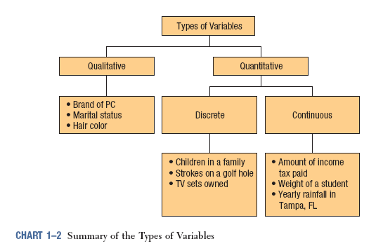
Summary of Types of Variables
LO4

Slide 19
Thank You

